Slide 1
Data Structures and Algorithms
Workshop

Slide 2
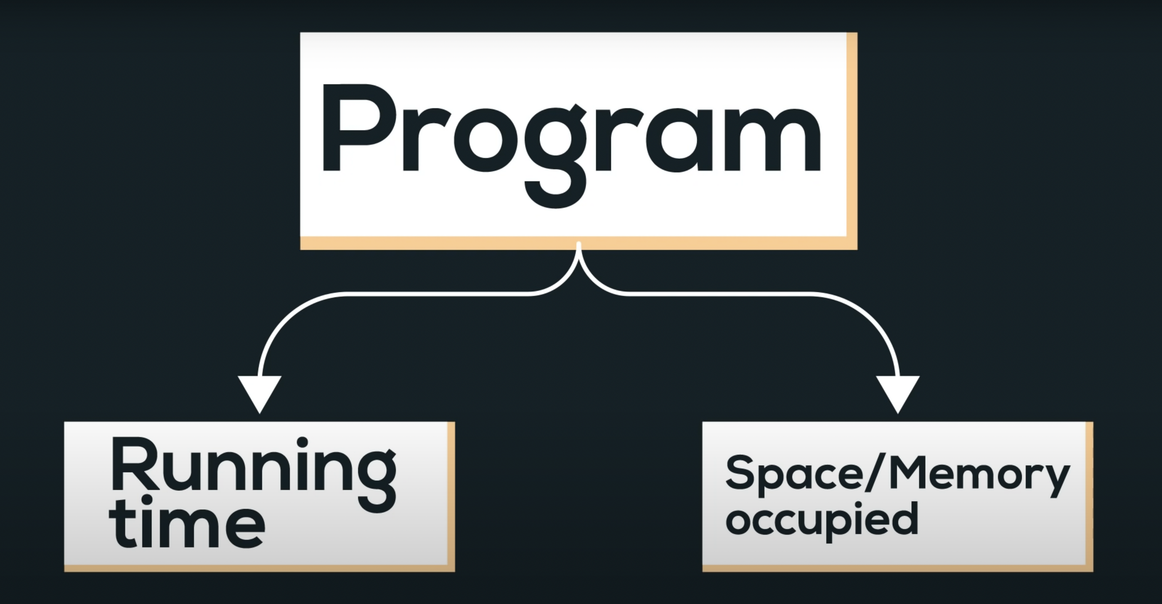

Slide 3
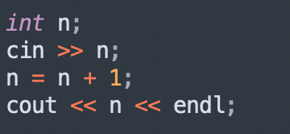
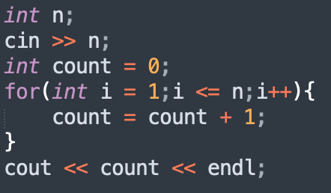
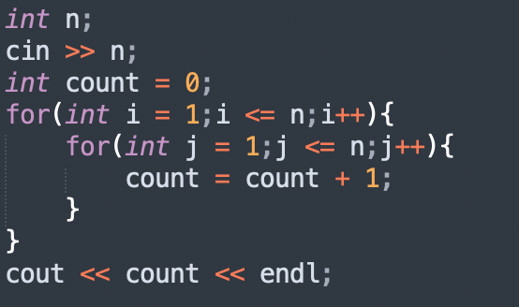
Time complexity
Time Complexity of an algorithm quantifies the amount of time taken by a program to run as a function of length of the input.
The Time Complexity of an algorithm/code is not equal to the actual time required to execute a particular code, but the number of times a statement executes.

Slide 4
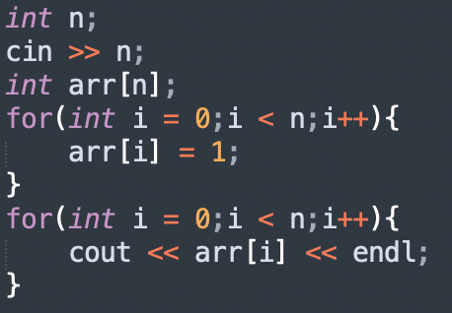
Space complexity
The space Complexity of an algorithm is the total space taken by the algorithm with respect to the input size.
It is directly proportional to the largest memory your program acquires at any instance during runtime.

Slide 5
Worst, Average & Best Cases
Worst Case Analysis (Mostly used) - In the worst-case analysis, we calculate the upper bound on the running time of an algorithm.
We must know the case that causes a maximum number of operations to be executed.
We define an algorithm’s worst-case time complexity by using the Big-O notation.
2 | 3 | 7 | 5 | 10 | 1 | 11 | 8
Target Value -
Case 1: 2
Case 2: 10
Case 3: 8
Case 4: 15

Slide 6
Best Case Analysis: In the best case analysis, we calculate the lower bound on the running time of an algorithm.
We must know the case that causes a minimum number of operations to be executed.
We define an algorithm’s best-case time complexity by using the Omega notation Ω(1) .
In the linear search problem, the best case occurs when target is present at the first location.
Average Case Analysis - In average case analysis, we take all possible inputs and calculate the computing time for all of the inputs.
Sum all the calculated values and divide the sum by the total number of inputs. We must know (or predict) the distribution of cases.
We define an algorithm’s best-case time complexity by using the Theta notation Ω(1) .

Slide 7
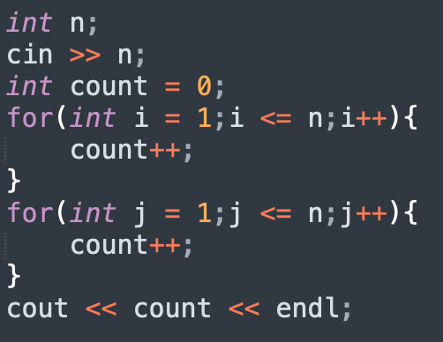
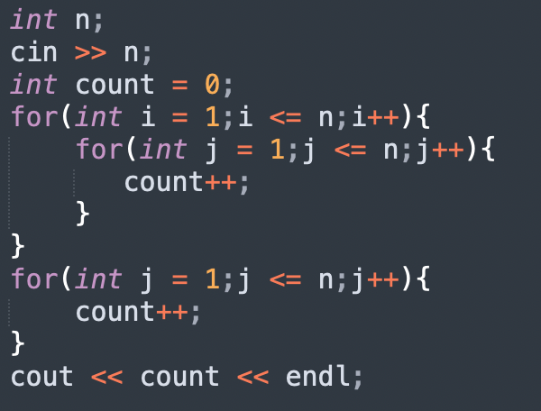

Slide 8
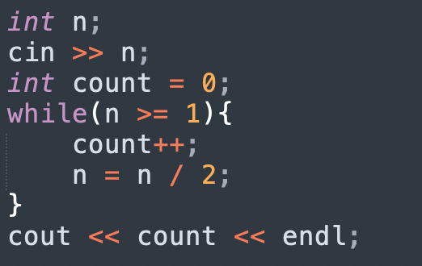
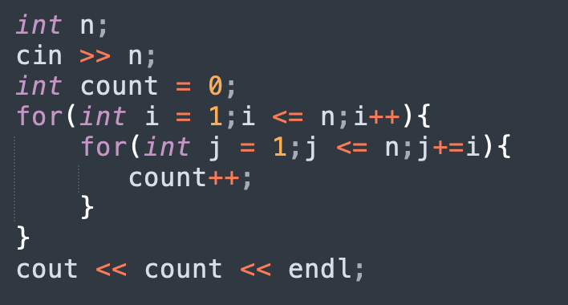

Slide 9
Comparison of various time complexities
n | O(n) | O(n²) | O(n³) | log(n)
1 | 1 | 1 | 1 | 1
10 | 10 | 10² | 10³ | 3
10² | 10² | 10⁴ | 10⁶ | 7
10³ | 10³ | 10⁶ | 10⁹ | 10

Slide 10
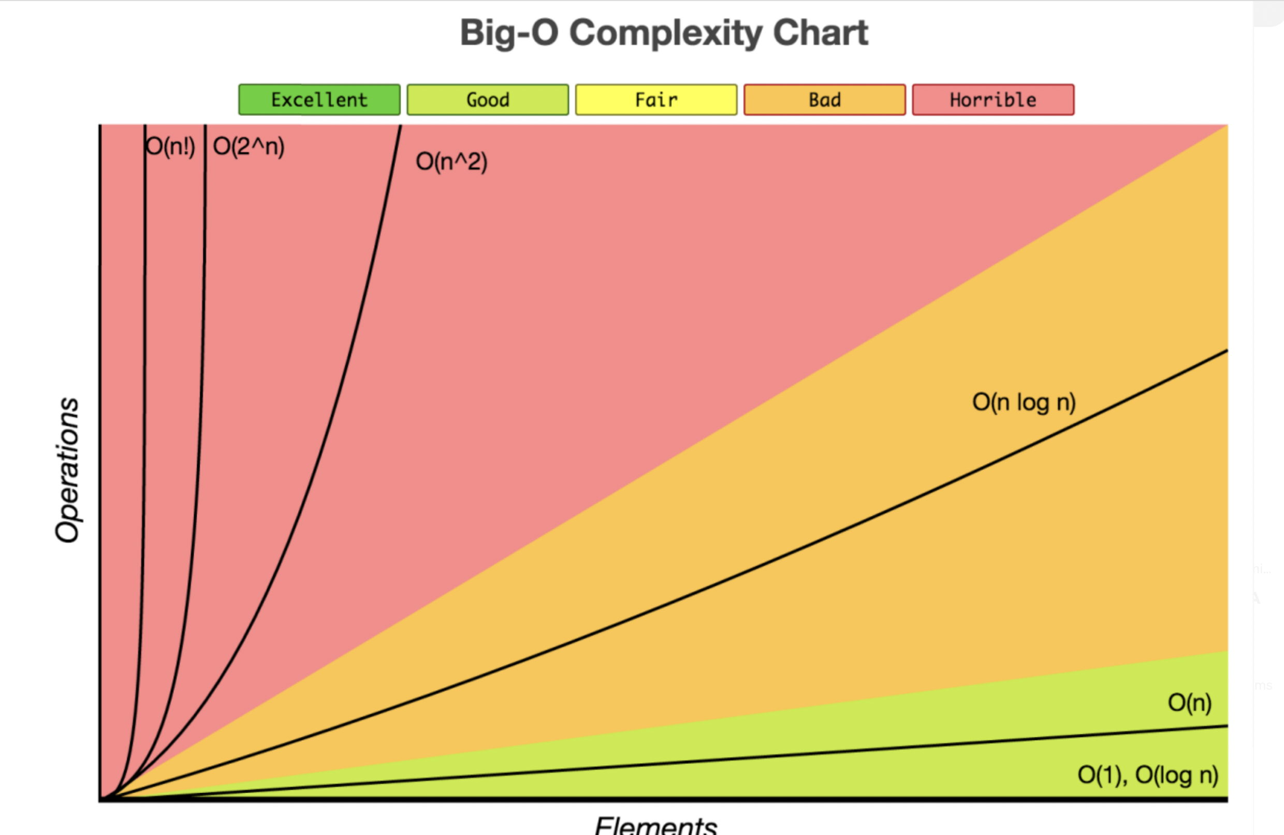

Slide 11
Importance of Time complexity
Time complexity is one of the most important factors in determining the efficiency of your code.

Slide 12
Binary search
Binary Search is a searching algorithm used for finding an element's position in a sorted array. It is one of the most important algorithms in the world.
Binary search follows the divide and conquer approach in which the list is divided into two halves, and the item is compared with the middle element of the list.
If the match is found then, the location of the middle element is returned. Otherwise, we search into either of the halves depending upon the result produced through the match.
Index | 0 | 1 | 2 | 3 | 4 | 5 | 6
Array | 2 | 3 | 5 | 6 | 8 | 10 | 12

Slide 13
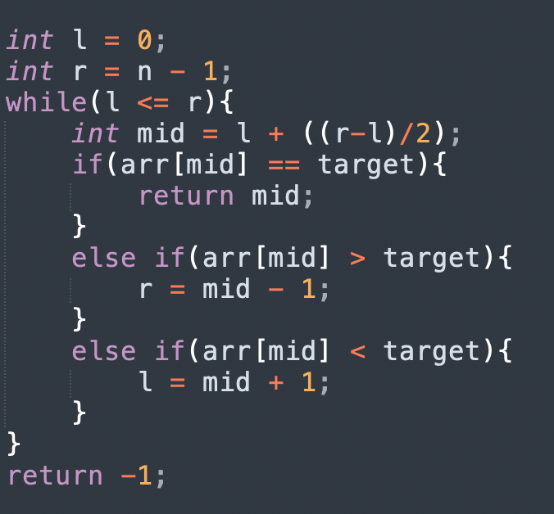
Implementation of Binary search

Slide 14
Quick Assessment
You have been given a number n. Check if the given number is perfect square or not.
You have been given n numbers. Return the first number greater than or equal to x.
Find the maximum element in an array which is first increasing and then decreasing.

Slide 15
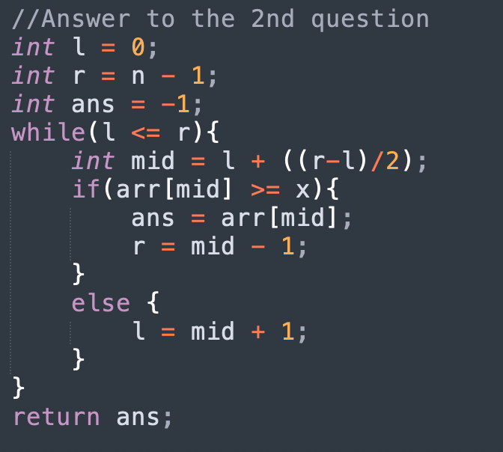

Slide 16
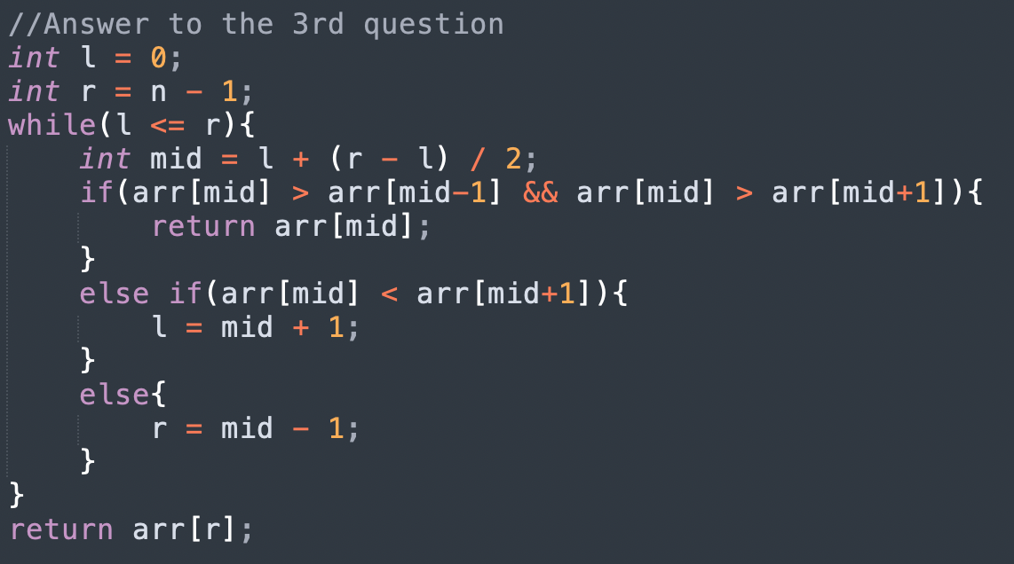

Slide 17
BINARY SEARCH ON ANSWER
Binary search can be applied to all problems where the state of a condition changes only once.
Multiple true followed by multiple false or multiple false followed by multiple true values.
Problems –
Mic Testing Problem
Wood Cutting Problem

Slide 18
Two pointers
Two pointers is really an easy and effective technique that is typically used for searching pairs in a sorted array.
Q. Given a sorted array A (sorted in ascending order), having N integers, find if there exists any pair of elements (A[i], A[j]) such that their sum is equal to X.

Slide 19
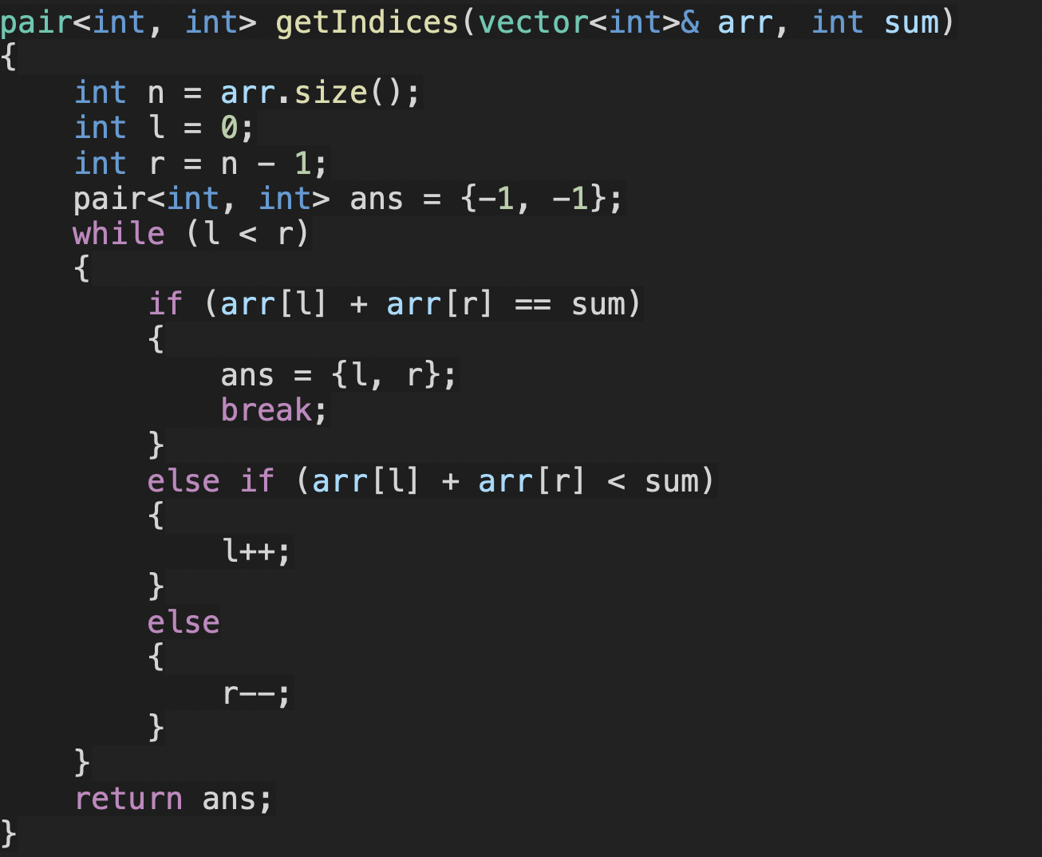

Slide 20
TIME COMPLEXITY ANALYSIS
Note: l is always incremented and never decremented (vice versa for r).
Therefore l can be incremented a maximum of n times and r can be
decremented a maximum of n times. Therefore the time complexity is O(N).

Slide 21
Quick Assessment
Given an array and a value, find if there is a triplet in array whose sum is equal to the given value.
Number of Pairs

Slide 22
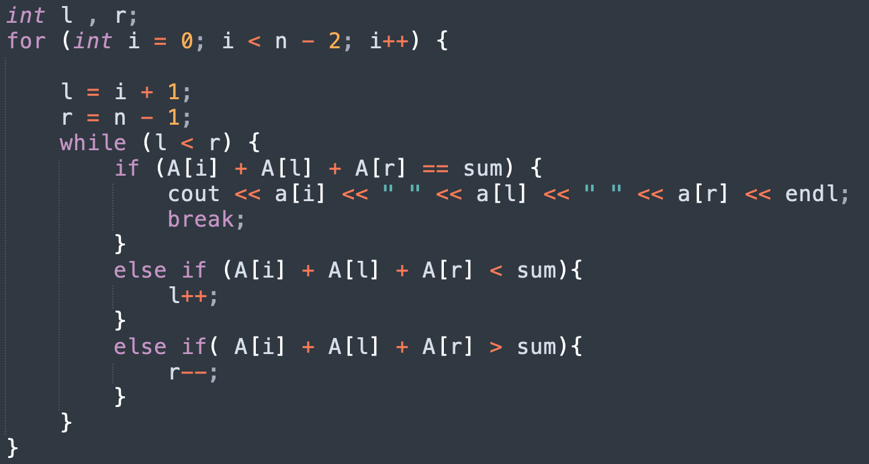

Slide 23
Greedy Algorithm
Greedy is an algorithmic paradigm that builds up a solution piece by piece, always choosing the next piece that offers the most obvious and immediate benefit. Greedy algorithms are used for optimization problems.
An optimization problem can be solved using Greedy if the problem has the following property: At every step, we can make a choice that looks best at the moment, and we get the optimal solution of the complete problem.

Slide 24
Quick Assessment
Given the weights and values of N items, put these items in a knapsack of capacity W to get the maximum total value in the knapsack.
You are given n activities with their start and finish times. Select the maximum number of activities that can be performed by a single person, assuming that a person can only work on a single activity at a time.
Given the arrival and departure times of all trains that reach a railway station, the task is to find the minimum number of platforms required for the railway station so that no train waits. We are given two arrays that represent the arrival and departure times of trains that stop.

Slide 25
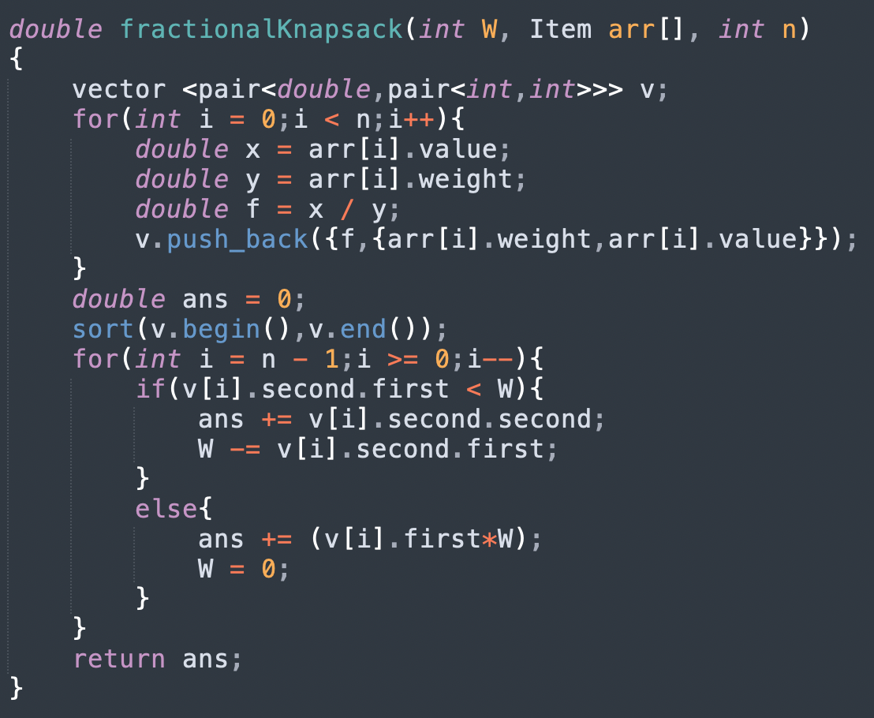

Slide 26
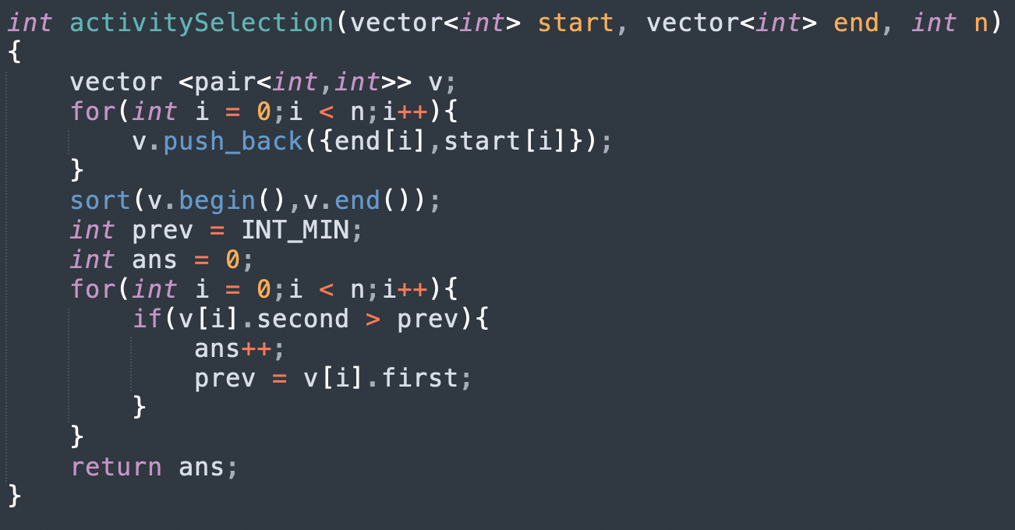

Slide 27
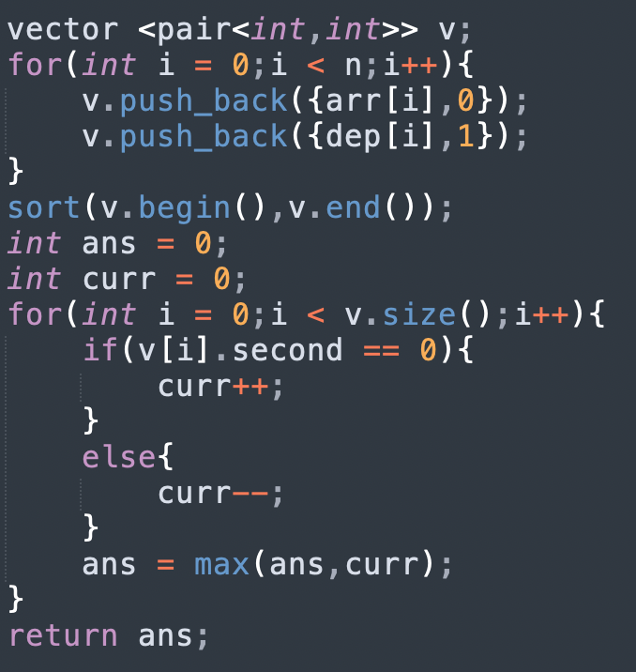

Slide 28
Kadane’s Algorithm
The algorithm can be used to calculate maximum subarray sum in O(N).
It greedily picks only the largest sum prefix for every I.
Q.Given an array Arr[] of N integers. Find the contiguous sub-array(containing at least one number) which has the maximum sum and return its sum.

Slide 29
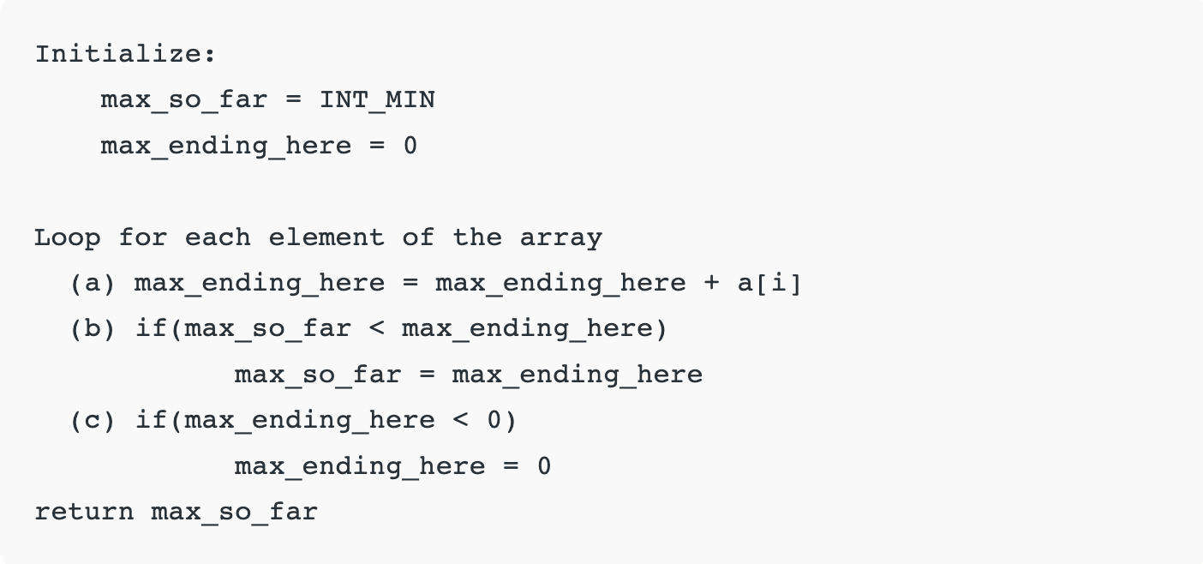

Slide 30
